Slide 1
Digital Image Processing
Lecture 8:
Image Enhancement in the Frequency Domain
Dr. Hossam Mahmoud Moftah
Assistant professor – Faculty of computers and information –
Beni Suef University

Slide 2
Some Basic Filters and Their Functions
Some Basic Filters and Their Functions
Correspondence between Filtering in the Spatial and Frequency Domain
Smoothing Frequency-Domain Filters
  Ideal lowpass filter (Lab Assignment using Matlab)
  Butterworth lowpass filter (Lab Assignment using Matlab)
  Gaussian lowpass filter (Lab Assignment using Matlab)
Sharpening Frequency Domain Filter
  Ideal highpass filter (Lab Assignment using Matlab)
  Butterworth highpass filter (Lab Assignment using Matlab)
  Gaussian highpass filter (Lab Assignment using Matlab)
  The Laplacian in the Frequency Domain (Lab Assignment using Matlab)

Slide 3
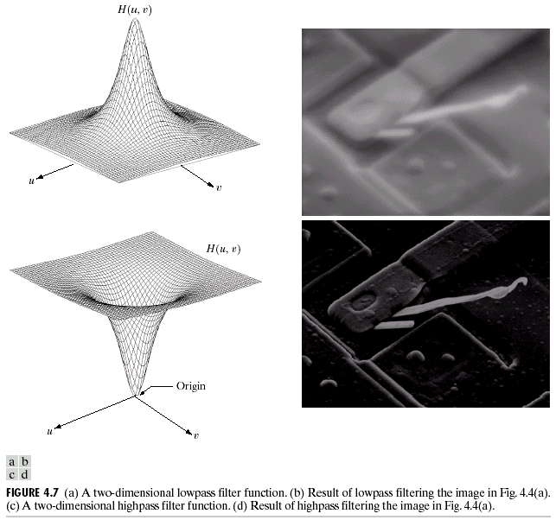
Some Basic Filters and Their Functions
Lowpass filter
Highpass filter

Slide 4
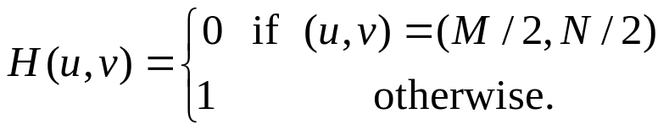
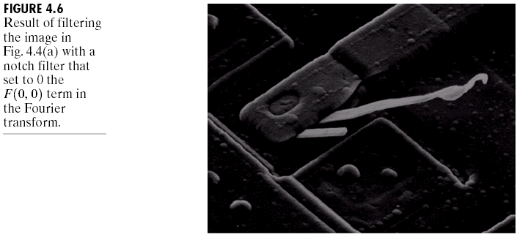
Some Basic Filters and Their Functions
Multiply all values of F(u,v) by the filter function (notch filter):
  All this filter would do is set F(0,0) to zero (force the average value of an image to zero) and leave all frequency components of the Fourier transform untouched.

Slide 5
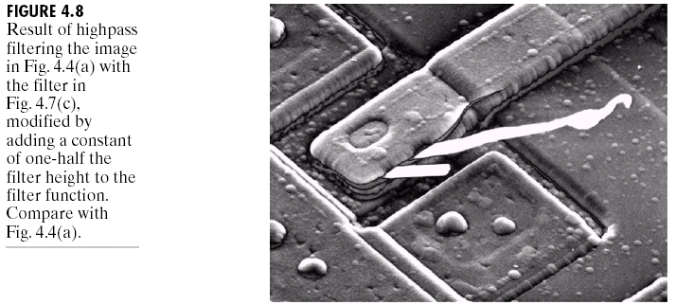
Some Basic Filters and Their Functions

Slide 6
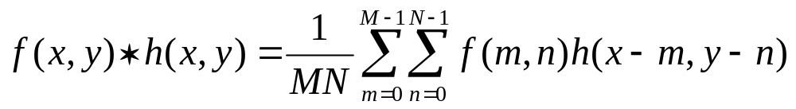
Correspondence between Filtering in
the Spatial and Frequency Domain
Convolution theorem:
  The discrete convolution of two functions f(x,y) and h(x,y) of size MXN is defined as
  Let F(u,v) and H(u,v) denote the Fourier transforms of f(x,y) and h(x,y), then
  Eq. (4.2-31)
  Eq. (4.2-32)

Slide 7
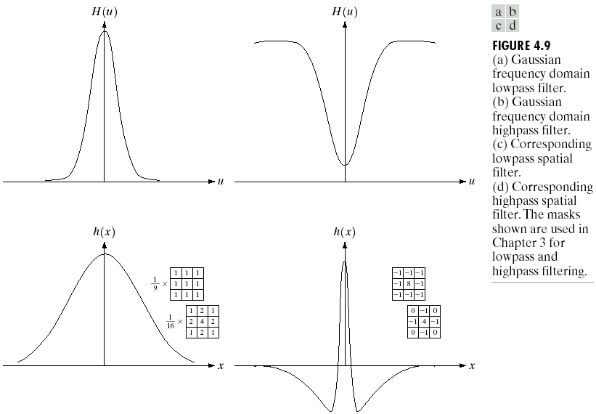
Correspondence between Filtering in
the Spatial and Frequency Domain

Slide 8
Correspondence between Filtering in
the Spatial and Frequency Domain
One very useful property of the Gaussian function is that both it and its Fourier transform are real valued; there are no complex values associated with them.
In addition, the values are always positive. So, if we convolve an image with a Gaussian function, there will never be any negative output values to deal with.
There is also an important relationship between the widths of a Gaussian function and its Fourier transform. If we make the width of the function smaller, the width of the Fourier transform gets larger. This is controlled by the variance parameter σ² in the equations.
These properties make the Gaussian filter very useful for lowpass filtering an image. The amount of blur is controlled by σ². It can be implemented in either the spatial or frequency domain.
Other filters besides lowpass can also be implemented by using two different sized Gaussian functions.

Slide 9

Smoothing Frequency-Domain Filters
The basic model for filtering in the frequency domain
where F(u,v): the Fourier transform of the image to be smoothed
H(u,v): a filter transfer function
Smoothing is fundamentally a lowpass operation in the frequency domain.
There are several standard forms of lowpass filters (LPF).
  Ideal lowpass filter
  Butterworth lowpass filter
  Gaussian lowpass filter

Slide 10
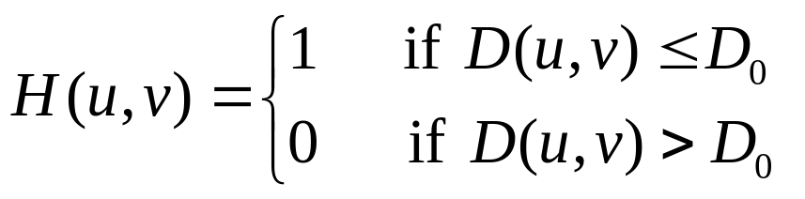
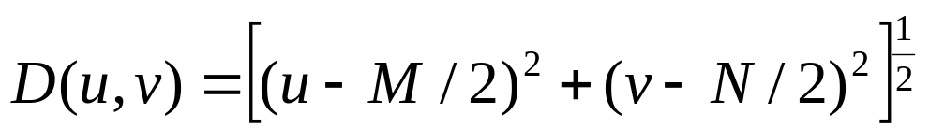
Ideal Lowpass Filters (ILPFs)
The simplest lowpass filter is a filter that “cuts off” all high-frequency components of the Fourier transform that are at a distance greater than a specified distance D₀ from the origin of the transform.
The transfer function of an ideal lowpass filter
where D(u,v) : the distance from point (u,v) to the center of ther frequency rectangle

Slide 11
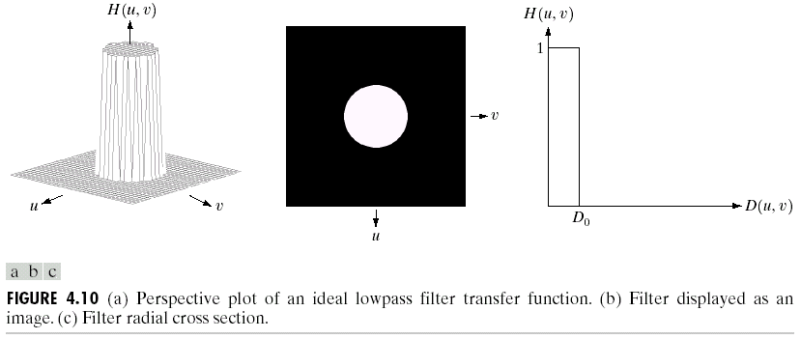
Ideal Lowpass Filters (ILPFs)

Slide 12
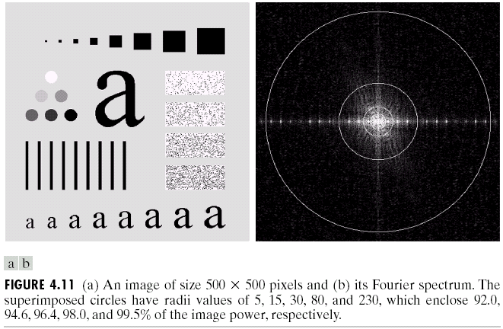
Ideal Lowpass Filters (ILPFs)

Slide 13
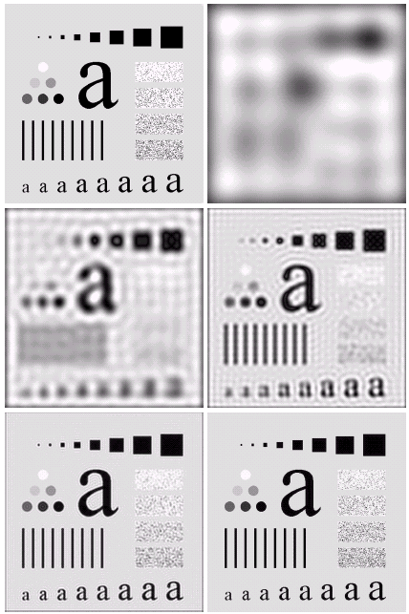

Ideal Lowpass Filters
Radii value = 5
and 8% from the total image power was removed (high frequencies)
Radii value = 230 and 0.5% from the total image power was removed (high frequencies)

Slide 14
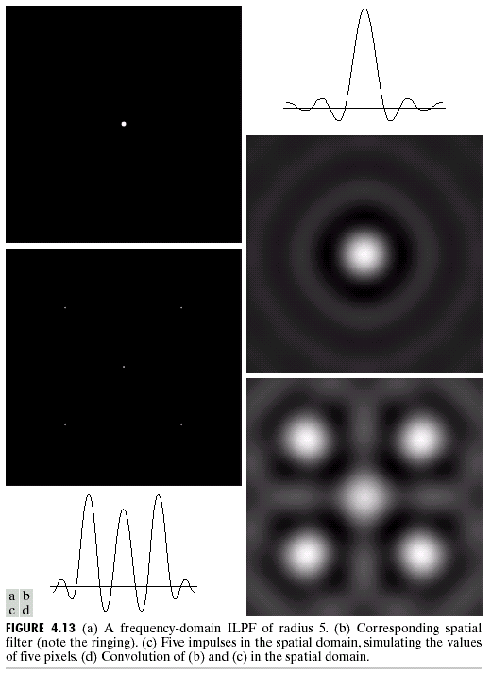
Ideal Lowpass Filters
Another Example
frequency
Figure 4.13 (a) A frequency-domain
ILPF of radius 5. (b) Corresponding
spatial filter. (c) Five impulses in the
spatial domain, simulating the values
of five pixels. (d) Convolution of (b)
and (c) in the spatial domain.
spatial
spatial
spatial

Slide 15
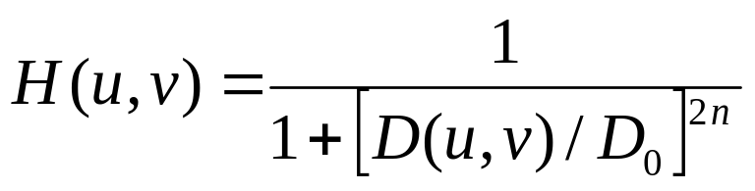
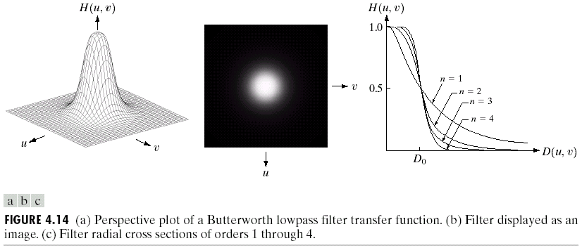
Butterworth Lowpass Filters (BLPFs)
With order n

Slide 16
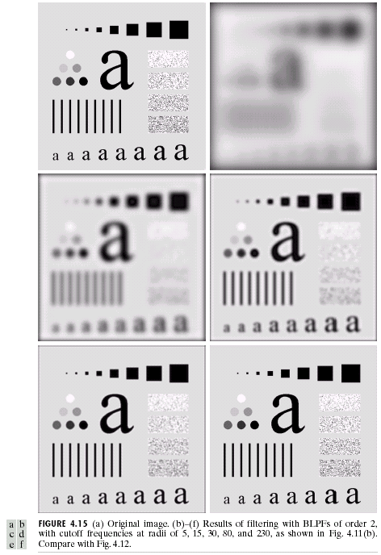
Butterworth Lowpass
Filters (BLPFs)
n=2
D₀=5,15,30,80,and 230

Slide 17
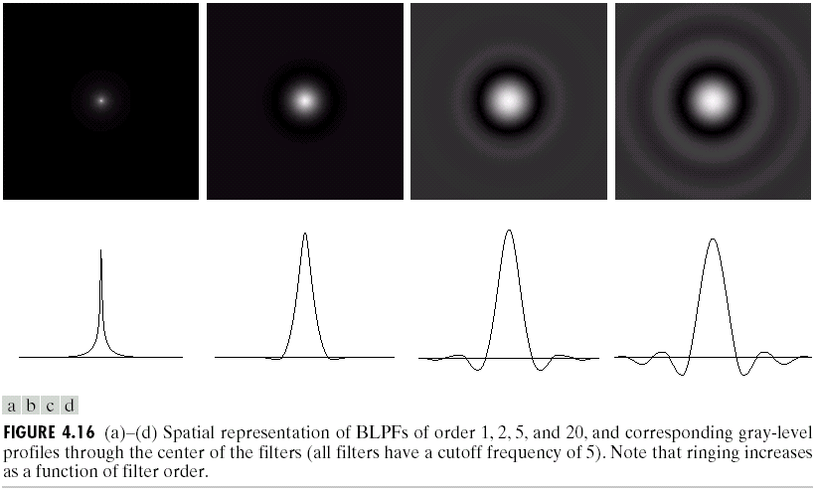
Butterworth Lowpass Filters (BLPFs)
Spatial Representation
n=1
n=2
n=5
n=20

Slide 18
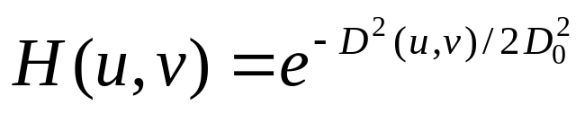
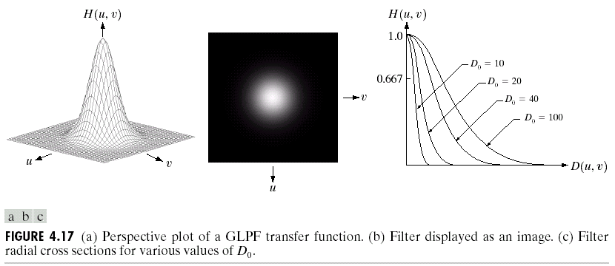
Gaussian Lowpass Filters (FLPFs)

Slide 19
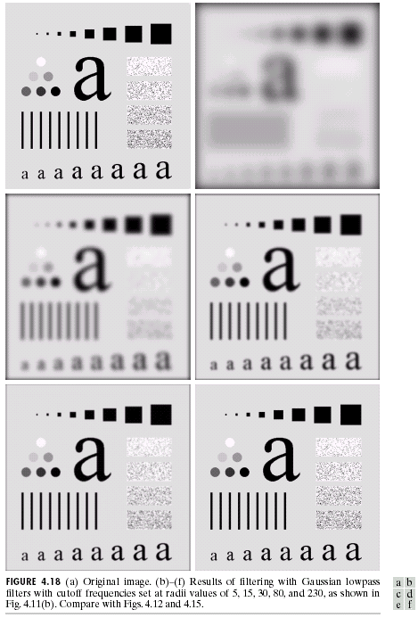
Gaussian Lowpass
Filters (FLPFs)
D₀=5,15,30,80,and 230

Slide 20
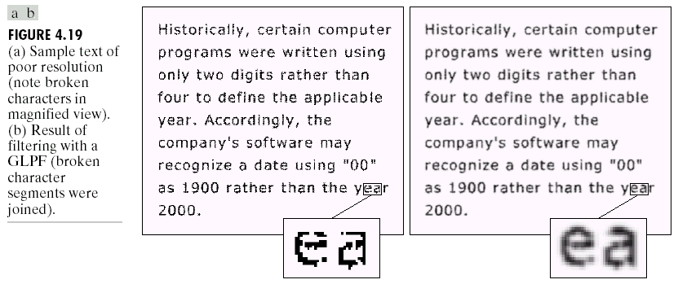
Additional Examples of Lowpass Filtering

Slide 21
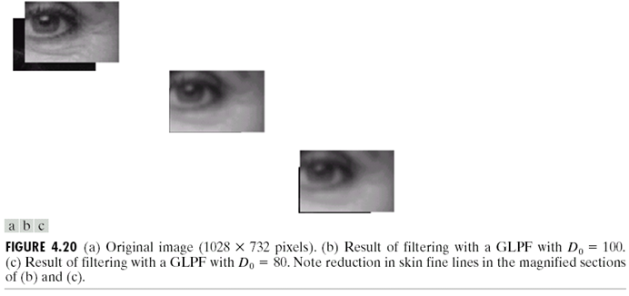
Additional Examples of Lowpass Filtering

Slide 22
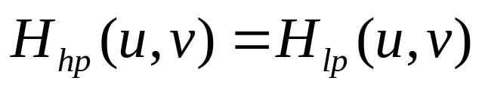
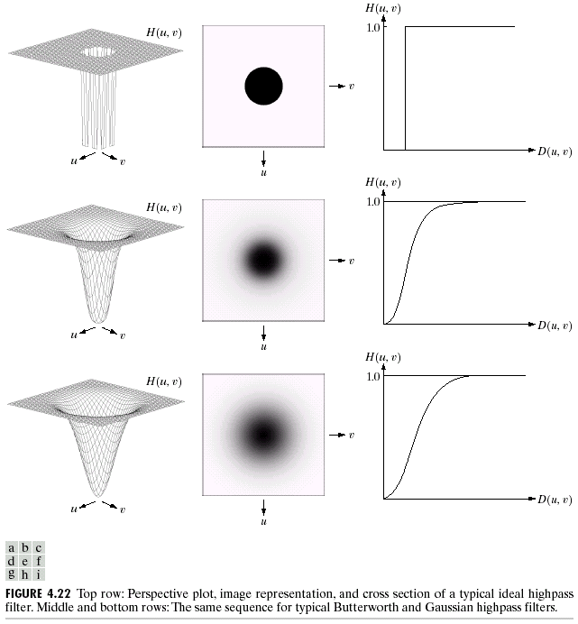
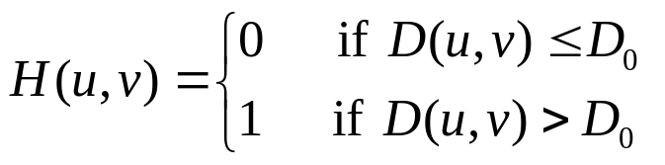
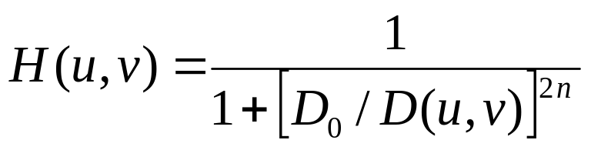
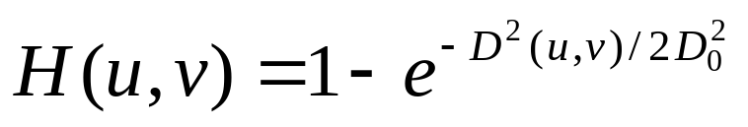
Sharpening Frequency Domain Filter
Ideal highpass filter
Butterworth highpass filter
Gaussian highpass filter

Slide 23
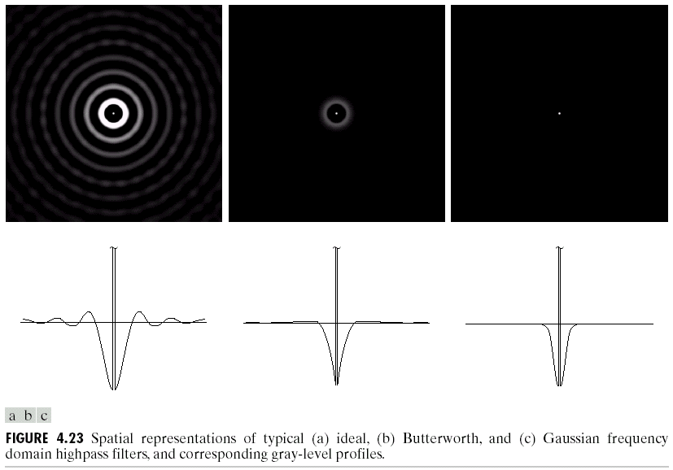
Highpass Filters
Spatial Representations

Slide 24
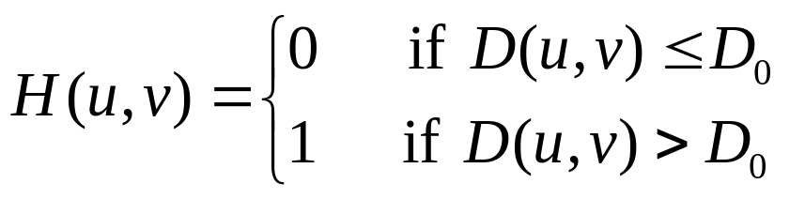
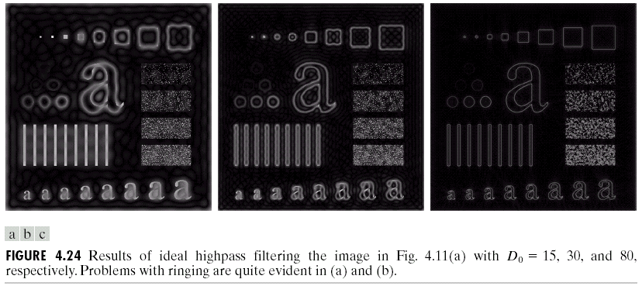
Ideal Highpass Filters

Slide 25
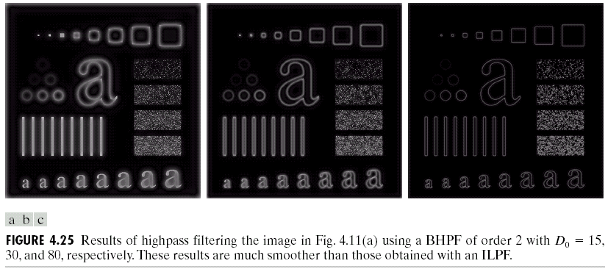
Butterworth Highpass Filters

Slide 26
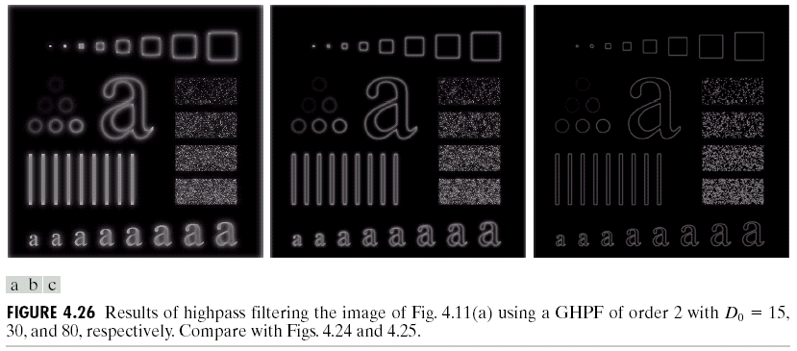
Gaussian Highpass Filters

Slide 27
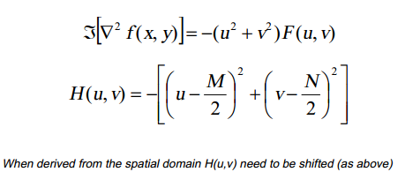
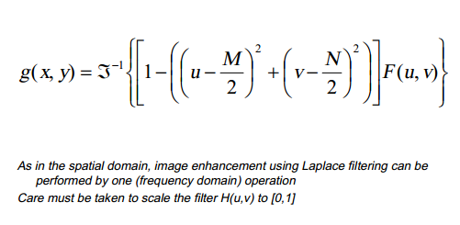
The Laplacian in the Frequency Domain

Slide 28
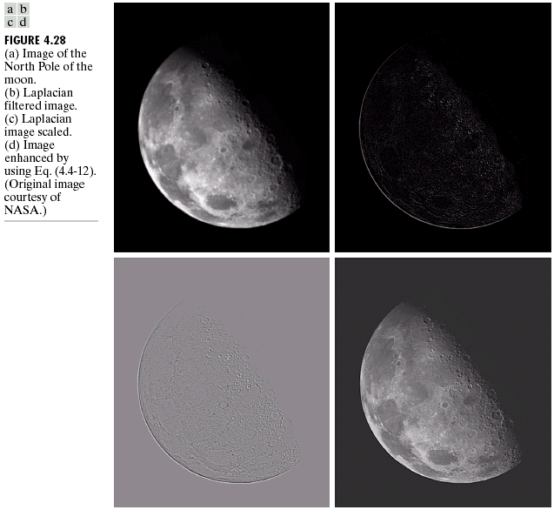

Slide 29
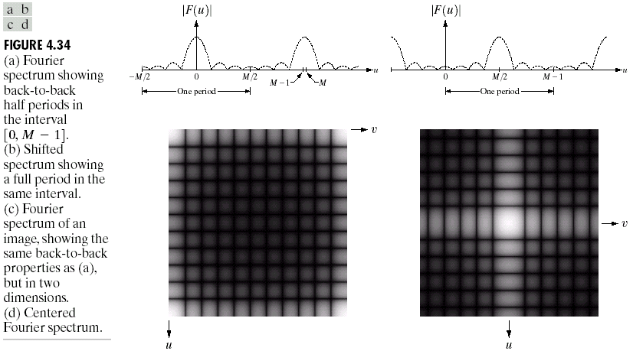
Implementation
Some Additional Properties of the 2D Fourier Transform
Periodicity, symmetry, and back-to-back properties
shift

Slide 30
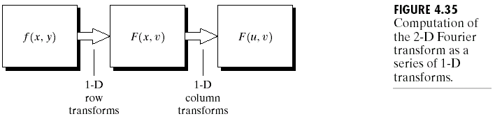
Implementation
Some Additional Properties of the 2D Fourier Transform
Separability

Slide 31
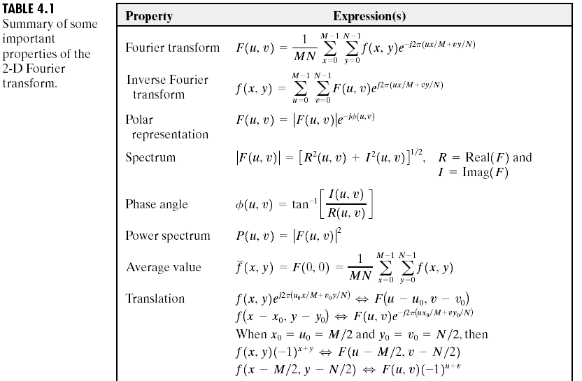
Summary of Some Important Properties
of the 2-D Fourier Transform

Slide 32
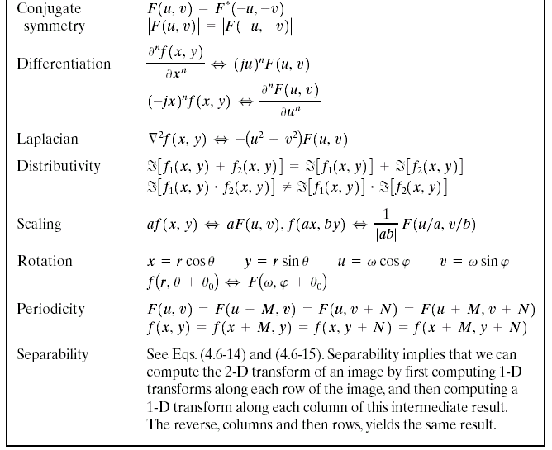

Summary of Some Important Properties
of the 2-D Fourier Transform

Slide 33
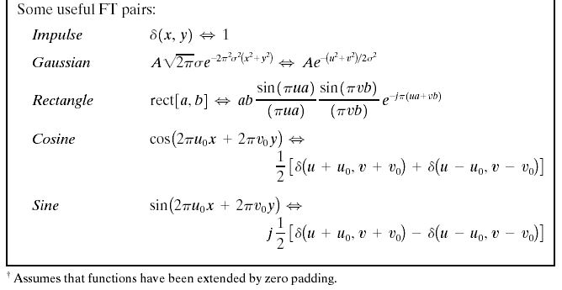
Summary of Some Important Properties
of the 2-D Fourier Transform

Slide 34
The end

